Slide 1
TABLE of CONTENT
- Introduction
- Objective
- Problem statement
- Dataset insights and Data collection
- Data cleaning and Data transformation
- Report and Visualization
- Dashboard
- Conclusion
- References

Slide 2
Introduction
Israel is the world’s only Jewish state, located just east of the Mediterranean Sea.
Palestinians, the Arab population that hails from the land Israel now controls, refer to the territory as Palestine, and want to establish a state by that name on all or part of the same land.
The Israeli-Palestinian conflict is over who gets what land and how it’s controlled. The 1967 war is particularly important for today’s conflict, as it left Israel in control of the West Bank and Gaza Strip, two territories home to large Palestinian populations.
Currently, Israel is at war with Hamas - a conflict following a horrific rampage on October 7, 2023, in which militants from Hamas and Palestinian Islamic Jihad, another extremist group, launched attacks that killed more than 1,400 Israelis and took more than 240 hostage. Israel has responded with widespread bombardment of Gaza Strip and a ground incursion, killing and injuring tens of thousands of Palestinians.

Slide 3
Israeli – Palestinian FATALITIES
Analysis OF FATALITY RATE FROM (2000 to 2023)

Slide 4
Objective
The aim of this project is to show the exploration process, the analytical methods and the findings of the Israeli – Palestinian fatalities rate for 23 years or more.

Slide 5
Problem statement
The problem statement of this analysis is aimed at:
Exploring the dataset and tracking the trend in fatalities over the time to identify any significant changes, spikes or declines in the number of fatalities.
To conduct a demographic analysis by examining the age, gender, and citizenship of individuals killed.
To use the event location, district and region information to perform geospatial analysis. This will be done by visualizing the distribution of fatalities on a map and identify areas that is most affected.
To investigate the extent of individuals participation in hostilities before their deaths, by analysing the relationship between participation and the circumstances surrounding each fatality.
To examine the types of injury inflicted on individuals, most common injures and assess their severity.
To analyse he ammunition and means by which the individuals were killed.
And finally to create a profile for victims to show the age, gender, citizenship, place of residence and what killed each of them.

Slide 6
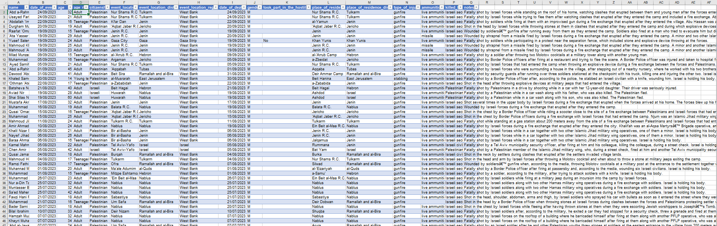
Dataset insight and data source
The dataset was gotten from Kaggle.com, it has 17 columns and over 7000 rows .
The insight on the dataset includes, data exploration and fatality trends analysis, Demographic Analysis, Geospatial analysis, Hostilities Participation Analysis, Injury Analysis, Analysis of weapon used, and finally the Victims Profile.

Slide 7
DATA CLEANING
This is the process of standardizing the dataset before creating a report.
It starts with understanding the dataset,
Removing or replacing “null” values and “blank” spaces in the dataset, for example in age column: central tendency was performed using the mean value (= 27) of the age to fill the null values and in gender column the mode value which is Male was filled with the blank spaces.
Filtering values and creating conditional column , (a conditional statement was created for group the age using if else statement.
Removing duplicate entries.
Changing the data type .

Slide 8
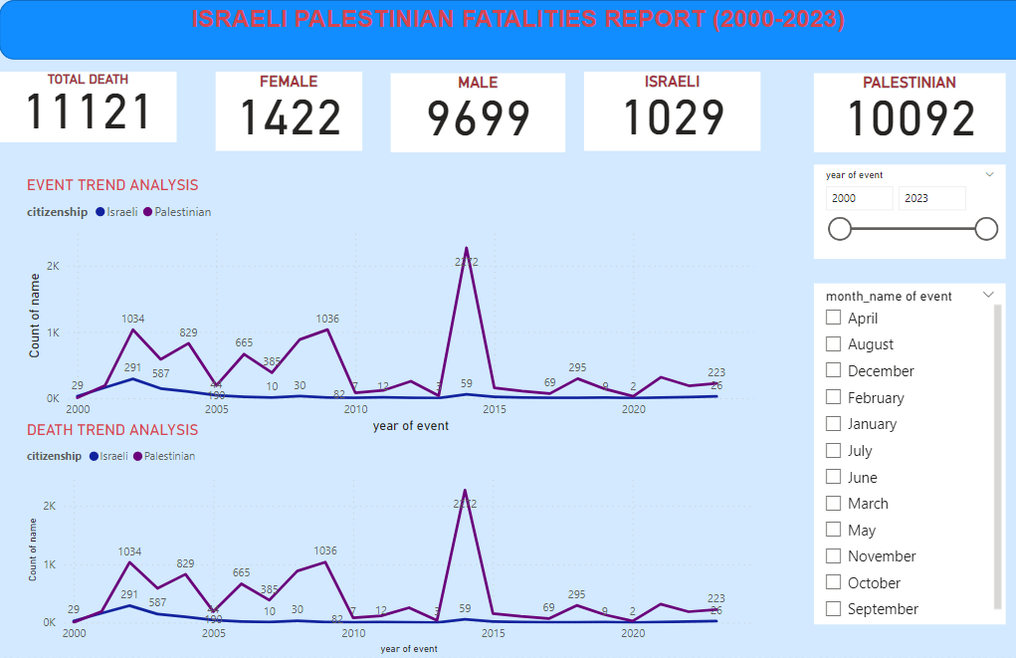
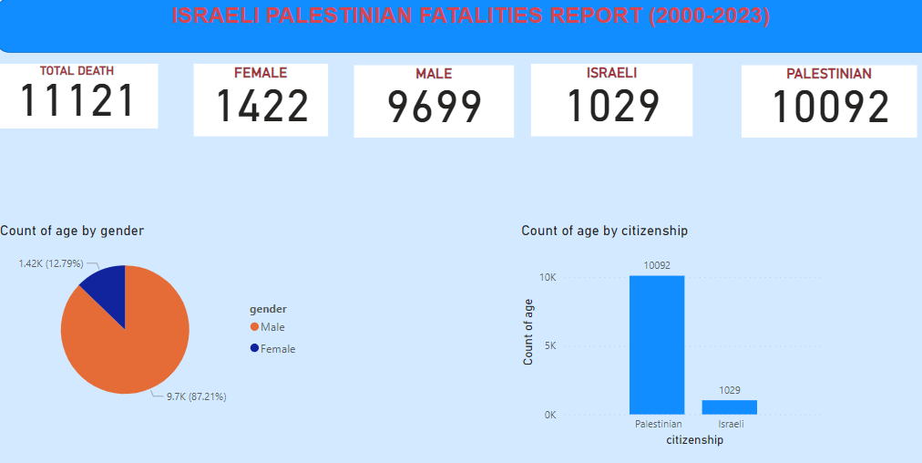
Report and visualization

Slide 9
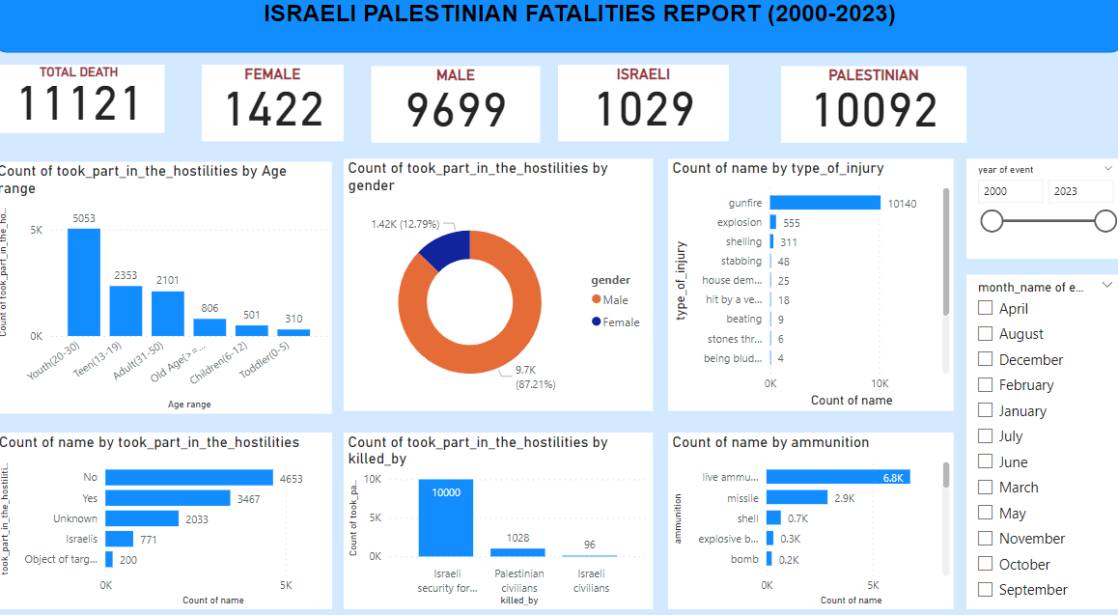
REPORT AND VISUALIZATION

Slide 10
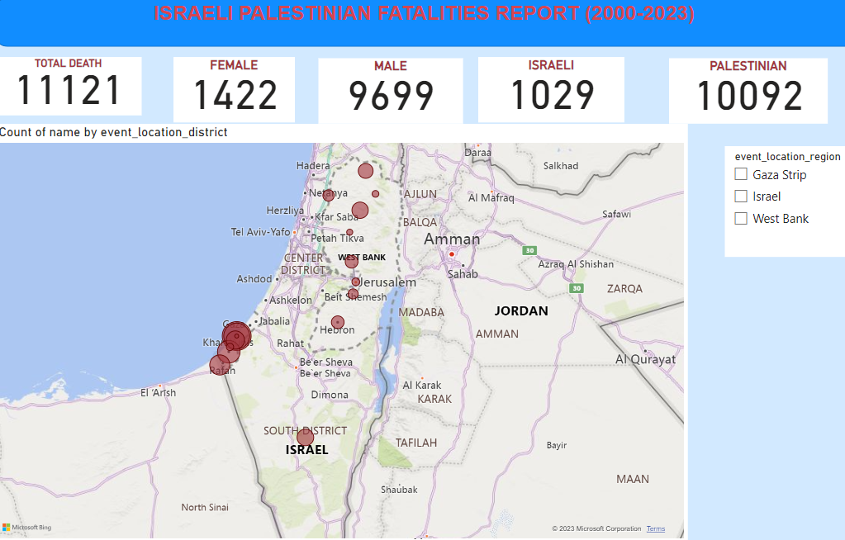
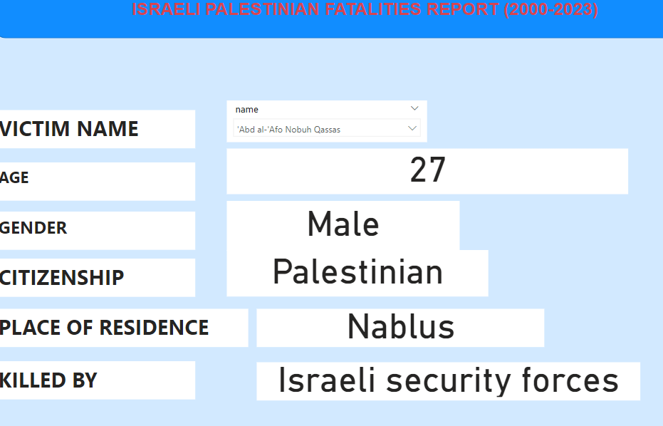
Report and visualization

Slide 11
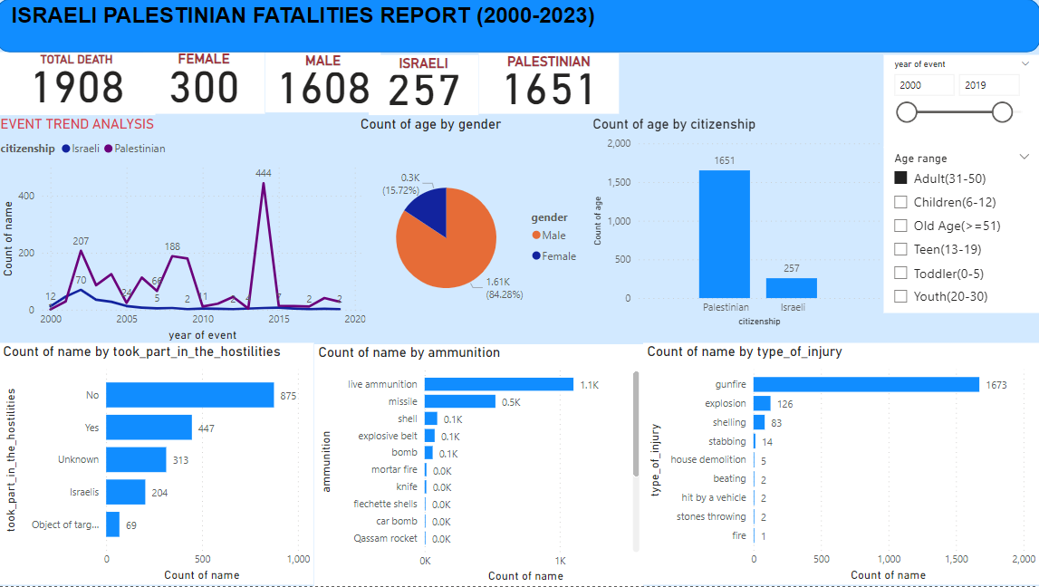
DASHBOARD

Slide 12
CONCLUSION
In conclusion 2014 recorded the highest number of fatalities and 87.2% of male were killed during the event. Gunfire was the most common type of injury by victims, a lot of Youths participated in Hostility before their death and were mostly killed by Israeli Security forces.

Slide 13
References
Zack Beauchamp (Nov 9, 2023). Everything you need to know about Israel-Palestine. Editor’s note.
Data collection - Kaggle.com

Slide 14
THANK YOU

